Slide 1


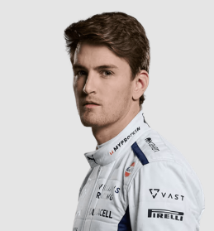
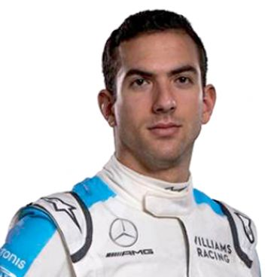
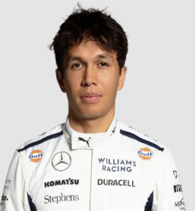

Final Presentation
Team Comparison based on historic performance
Williams Grand Prix Engineering Limited
Group 4

Slide 2


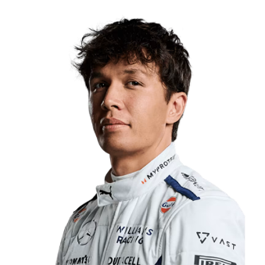




1
Player Comparison
Racer Introduction
Kevin Magnussen
Attending year:
’22, ’23, ‘24
Alexander Albon
Attending year:
’22, ’23, ‘24
Nico Hülkenberg
Attending year:
’23, ‘24
Logan Sargeant
Attending year:
’23, ‘24
Mick Schumacher
Attending year:
‘22
Nicholas Latifi
Attending year:
’22

Slide 3
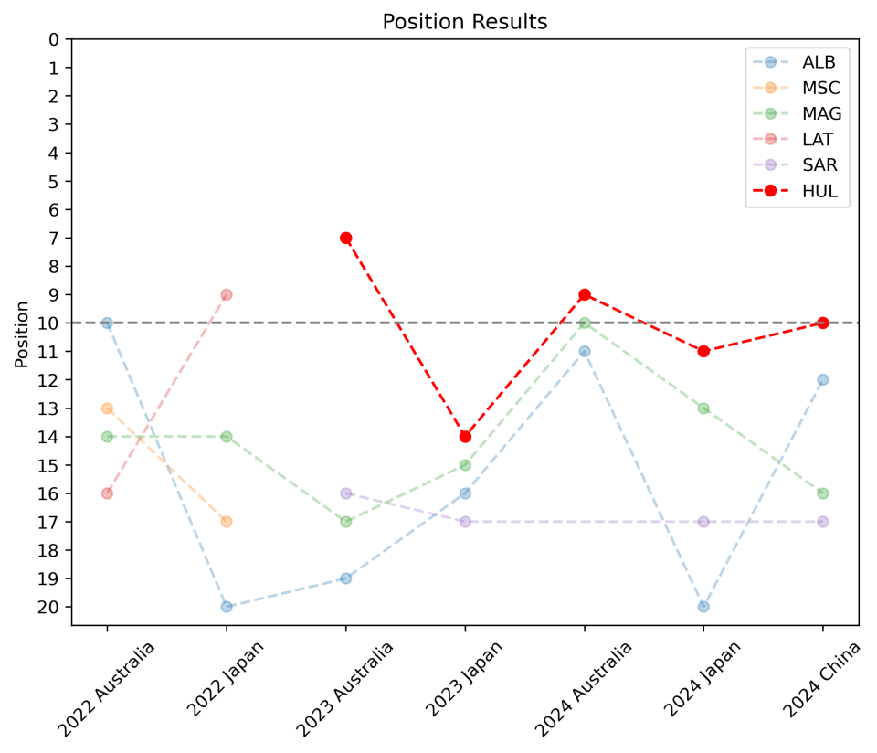
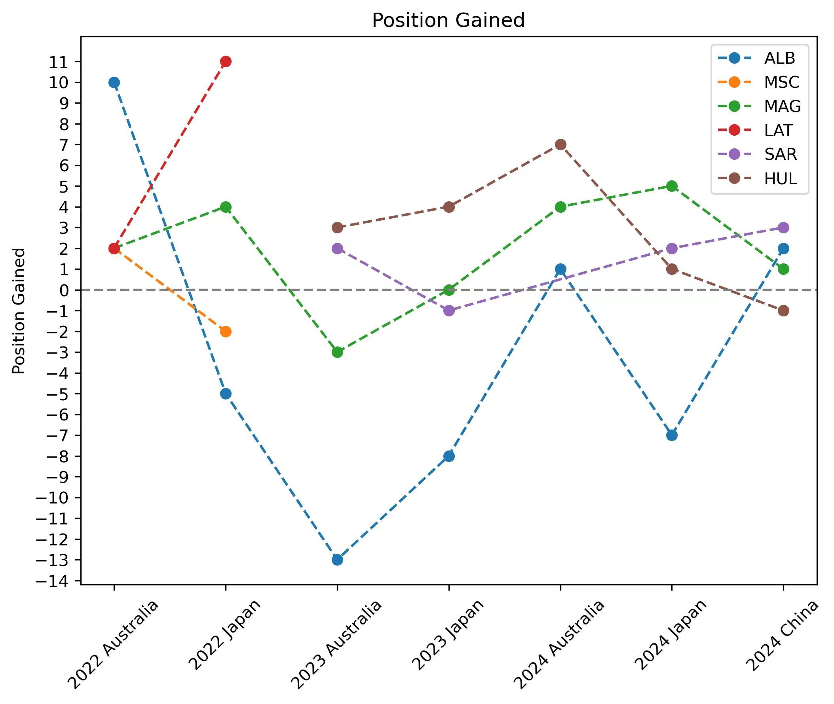
2.1
Data Analysis
PLAYER & TEAM Performance
Hulkenberg has a better ranking than others in these 7 races
Hulkenberg is relatively stable and outstanding, while Albon fluctuates greatly

Slide 4
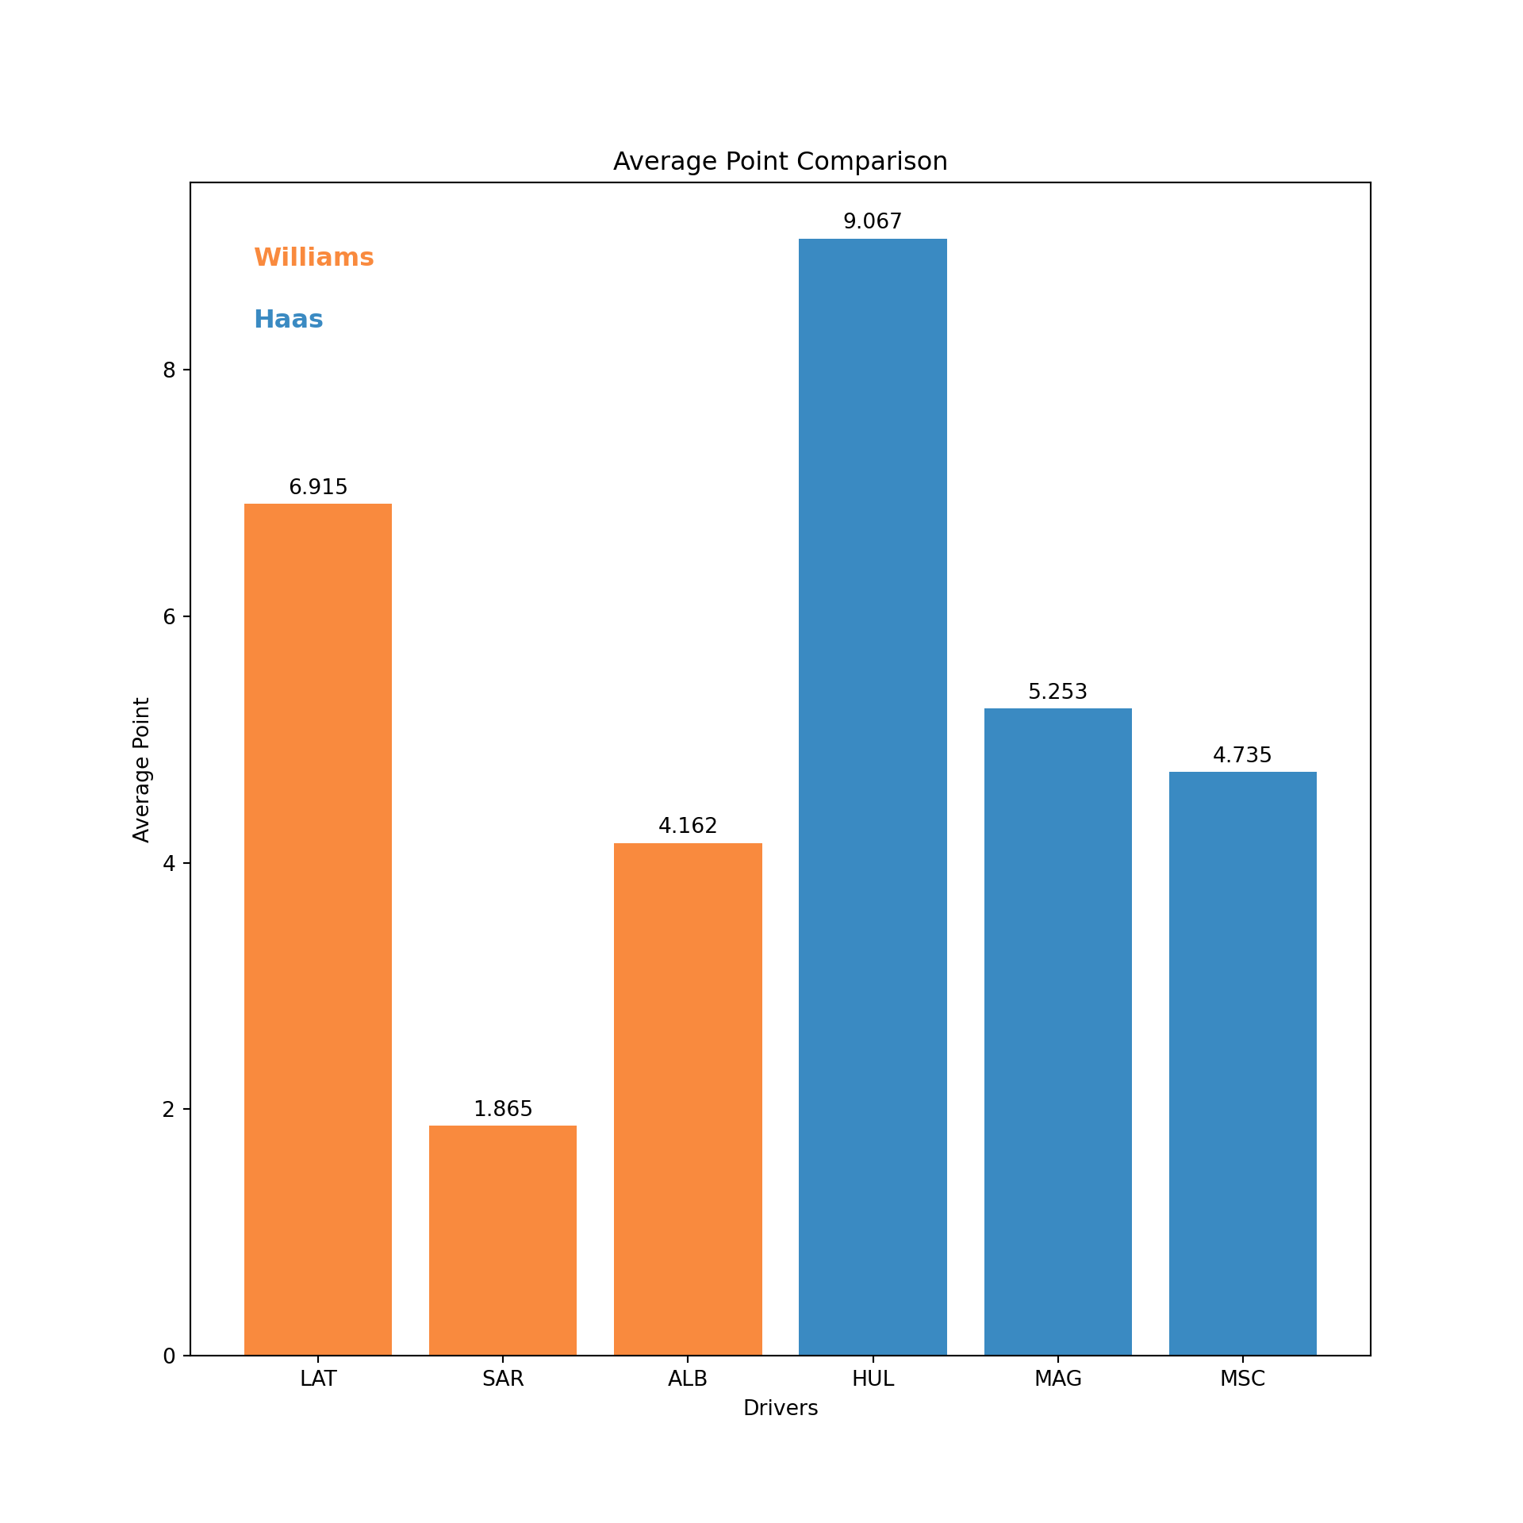
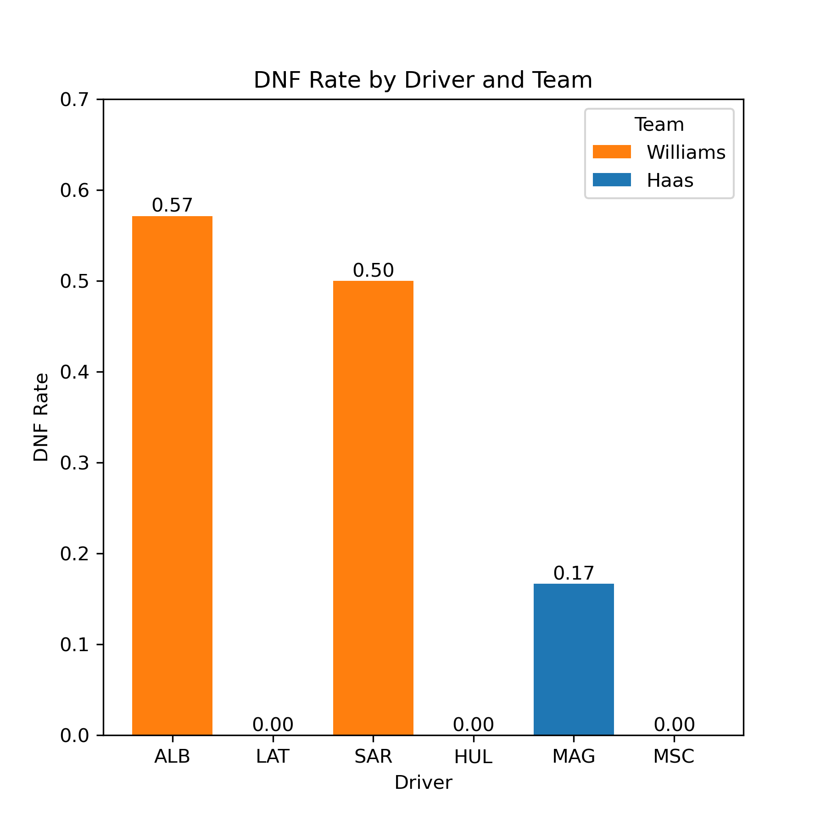
2.1
Data Analysis
PLAYER & TEAM Performance
Haas performs better based on our scoring model
Did Not Finish (DNF) rate of Williams is high

Slide 5
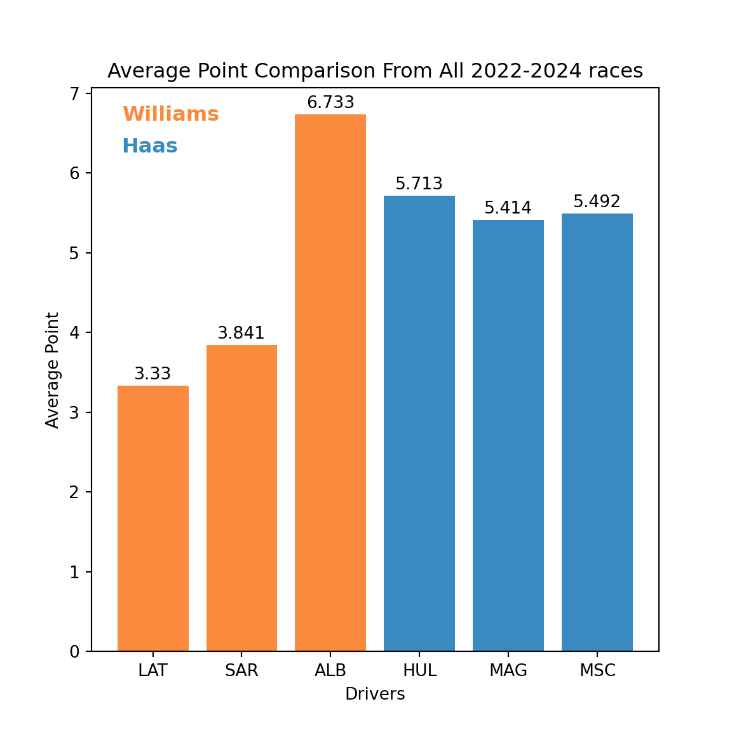
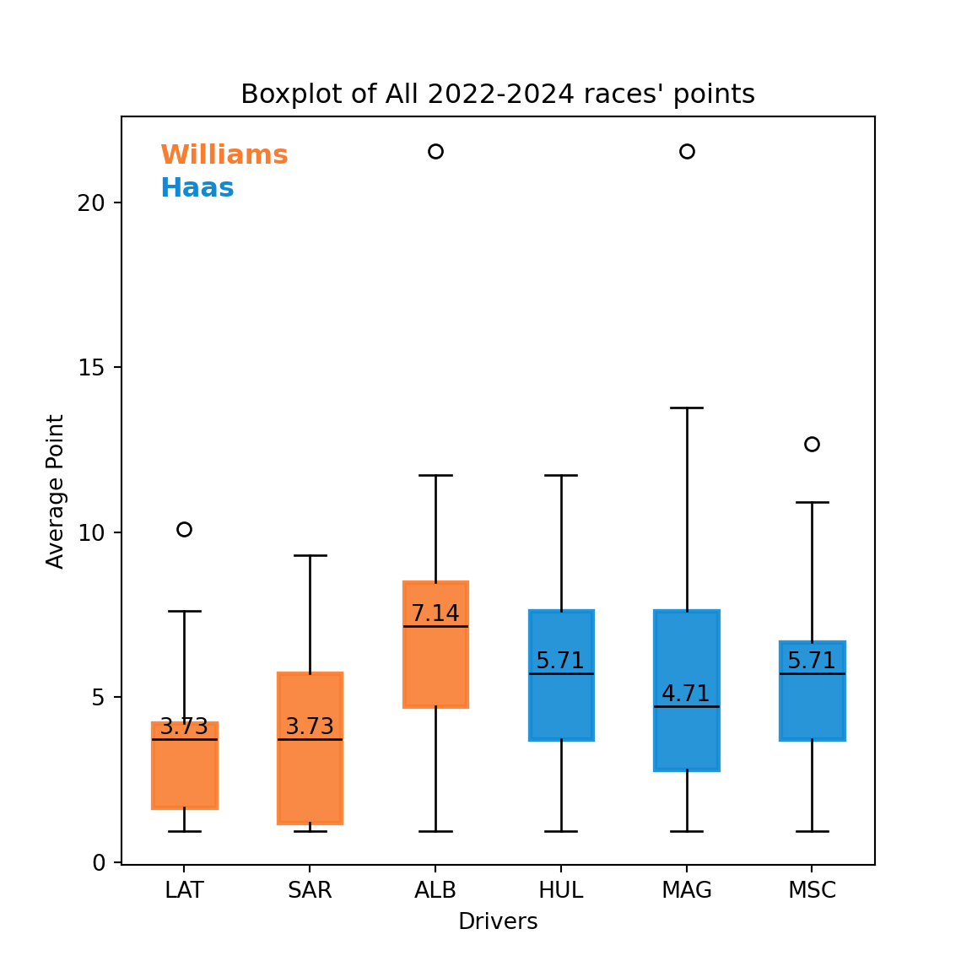
2.1
Data Analysis
PLAYER & TEAM Performance
Albon performs best in all races from 2022 to 2024 based on our scoring model

Slide 6
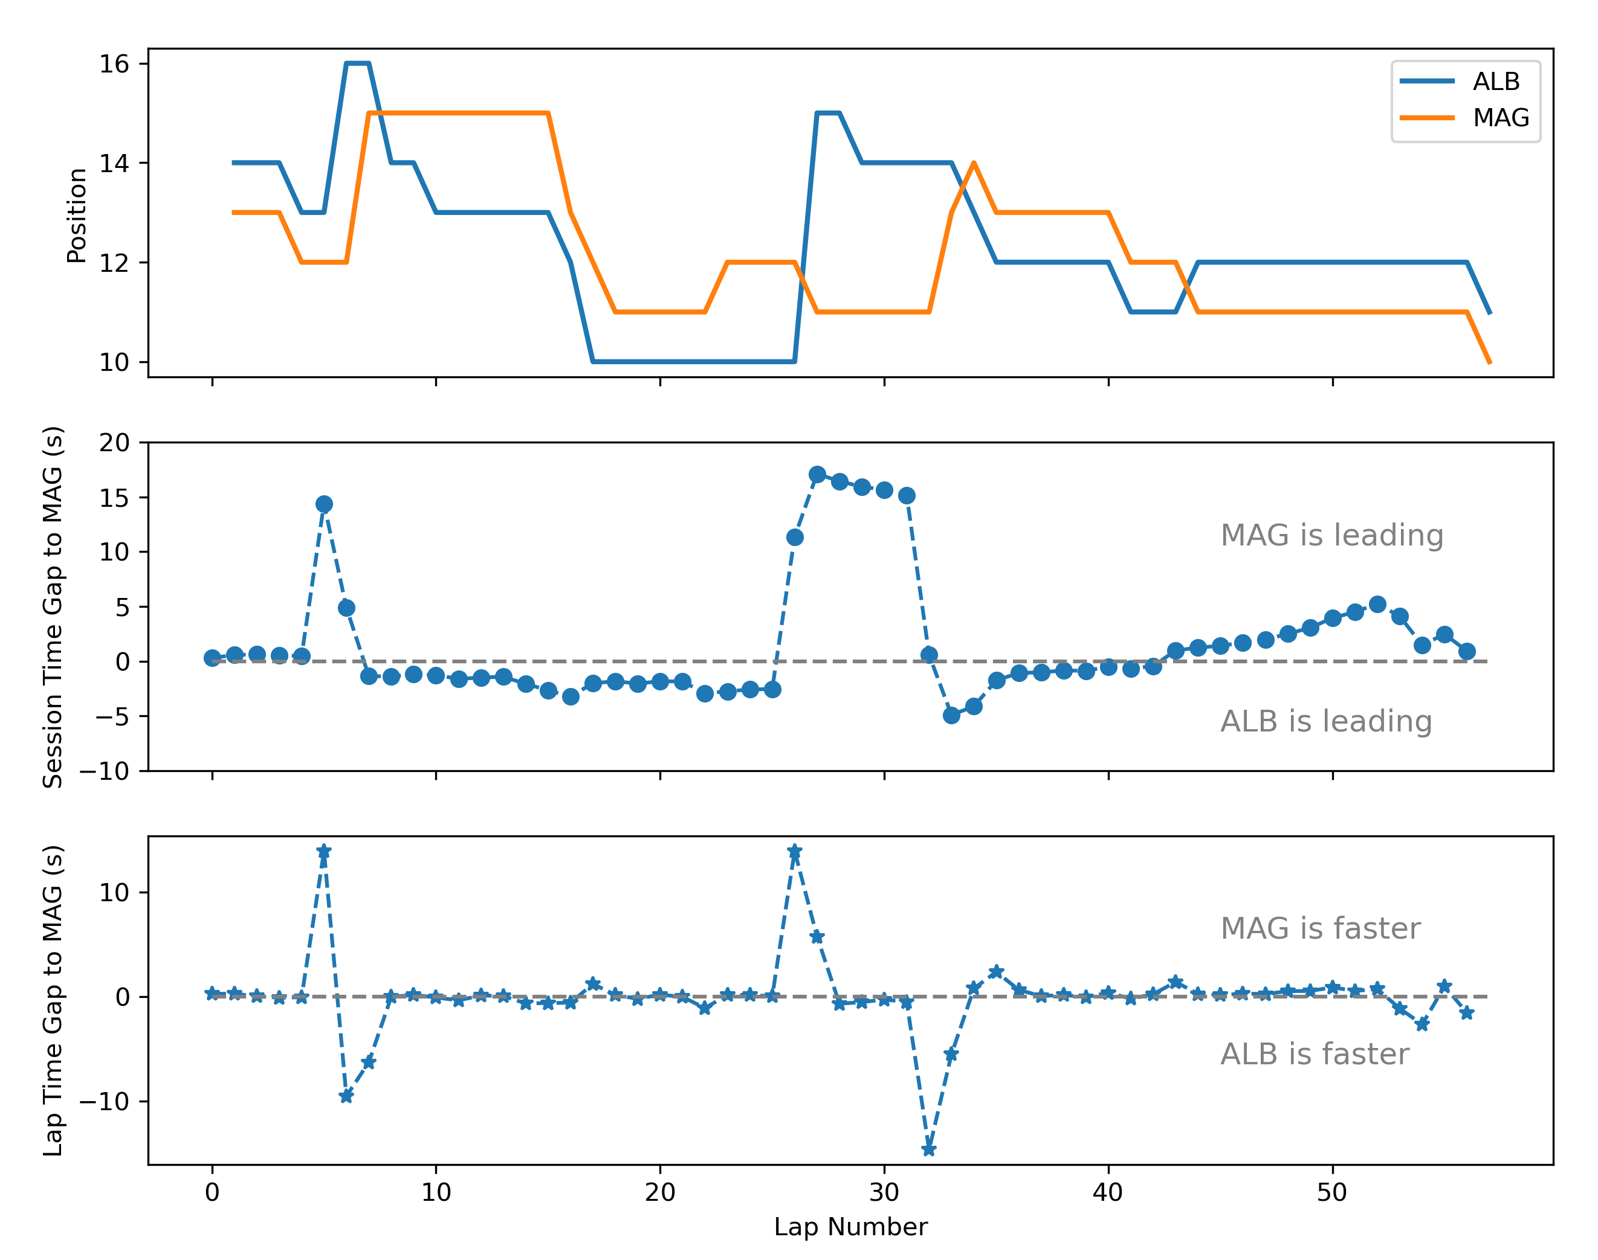
2.2
Data Analysis
2024 Australia Grand Prix
Lap comparison between Albon and Magnussen
Driving Sargeant’s car didn’t make Albon perform worse
Fierce competition for the point between Albon and Magnussen

Slide 7
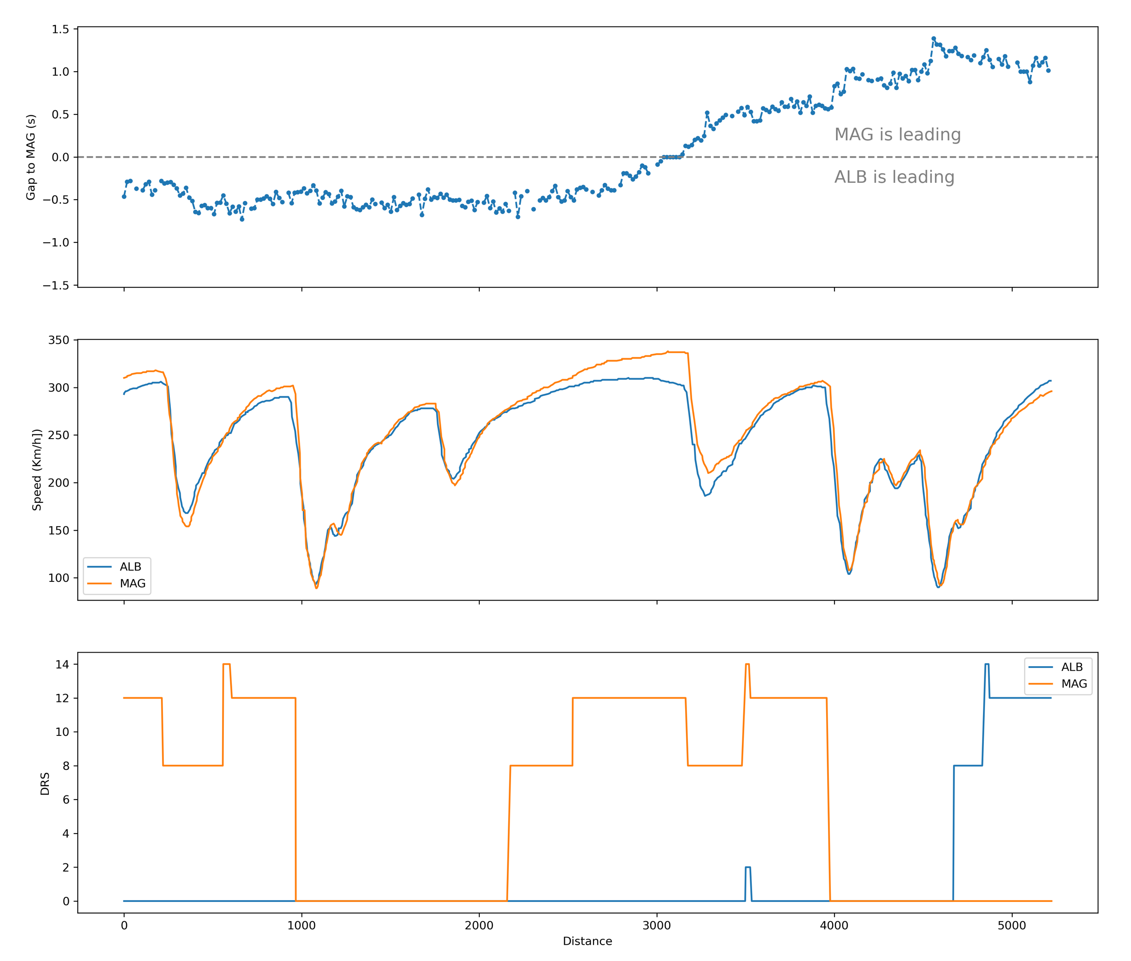
2.2
Data Analysis
2024 Australia Grand Prix
Magnussen overtook Albon in the lap 44 due to DRS, and kept leading for the rest laps

Slide 8
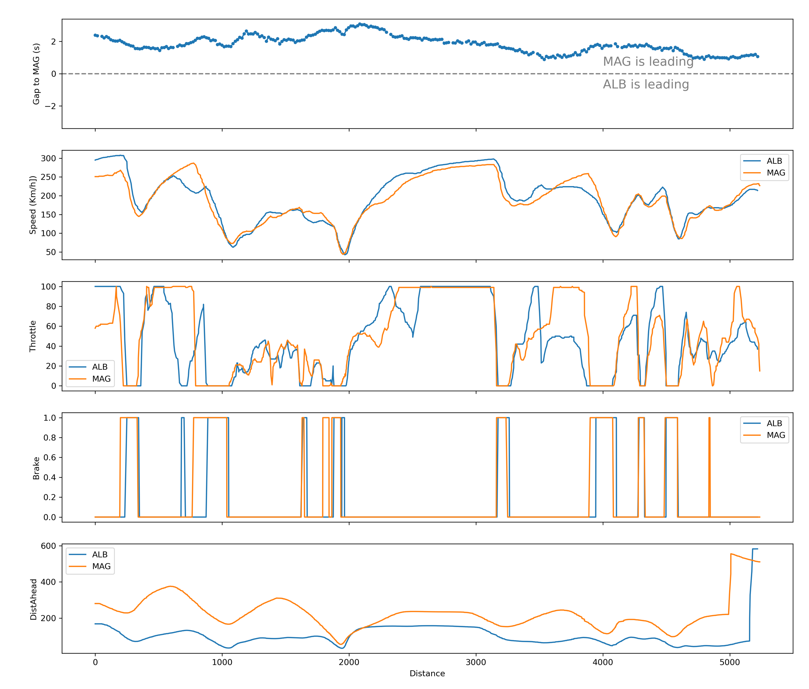
2.2
Data Analysis
2024 Australia Grand Prix
Two possible mistakes made Albon lose change to get point in the final lap

Slide 9
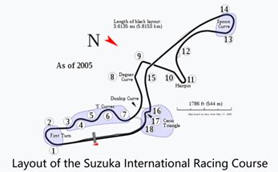
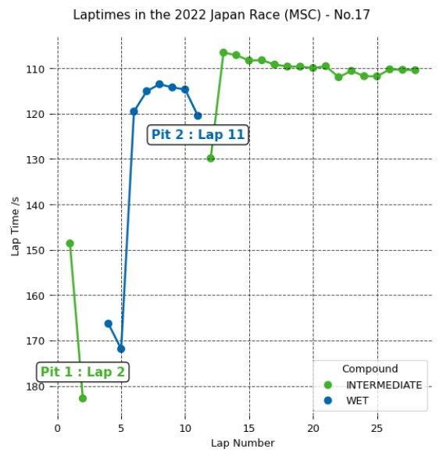
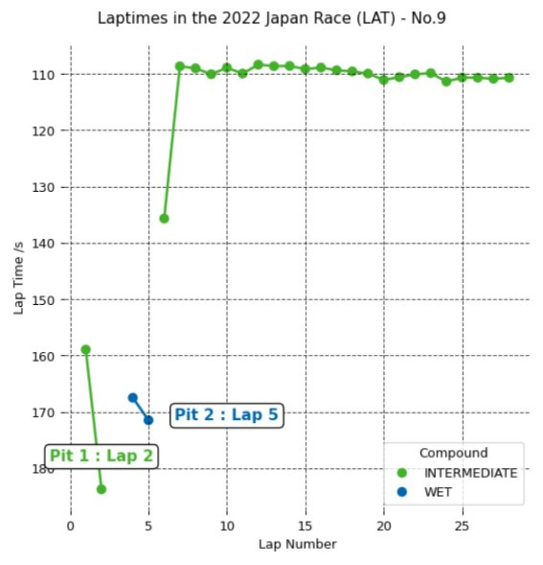
2.3
Data Analysis
2022 Japan Grand Prix
Bad tire strategy leads to bad outcome

Slide 10
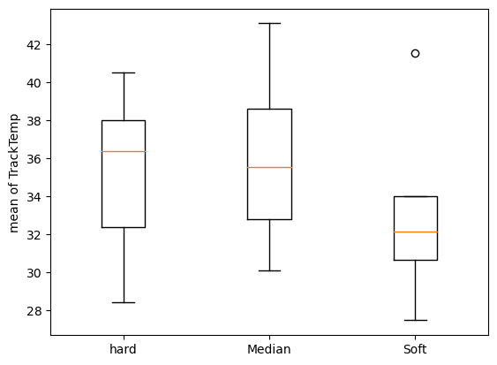
2.4
Data Analysis
Tire strategy​ with weather
As the track temperature decreases, we can choose soft tires with stronger grip for better performance

Slide 11
3
Conclusion
In these 7 games, Williams performs worse than Haas. The main reason is that ALB has more accidents, but ALB’s personal performance is averagely good and stable over the years.
From the results of Australia in 2024, ALB’s taking over of SAR’s car did not affect ALB’s performance a lot, instead stimulated ALB’s actively competing.
The team's prediction of the weather will greatly affect tire strategy, which in turn affects the driver's performance.
Track temperature also has a certain impact on tire selection.

Slide 12
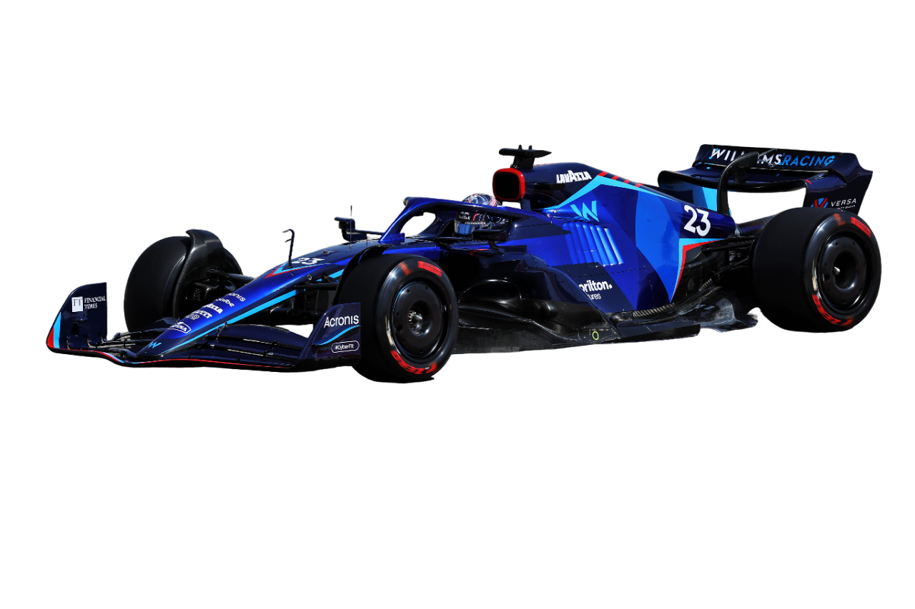
THANKS FOR LISTENING
MSDM 5005 Group 4

